Slide 1
Survey Research in CS/IS/IT
Disampaikan oleh:
Tim Pengajar MPPI
FACULTY OF COMPUTER SCIENCE,
UNIVERSITY OF INDONESIA

Slide 2
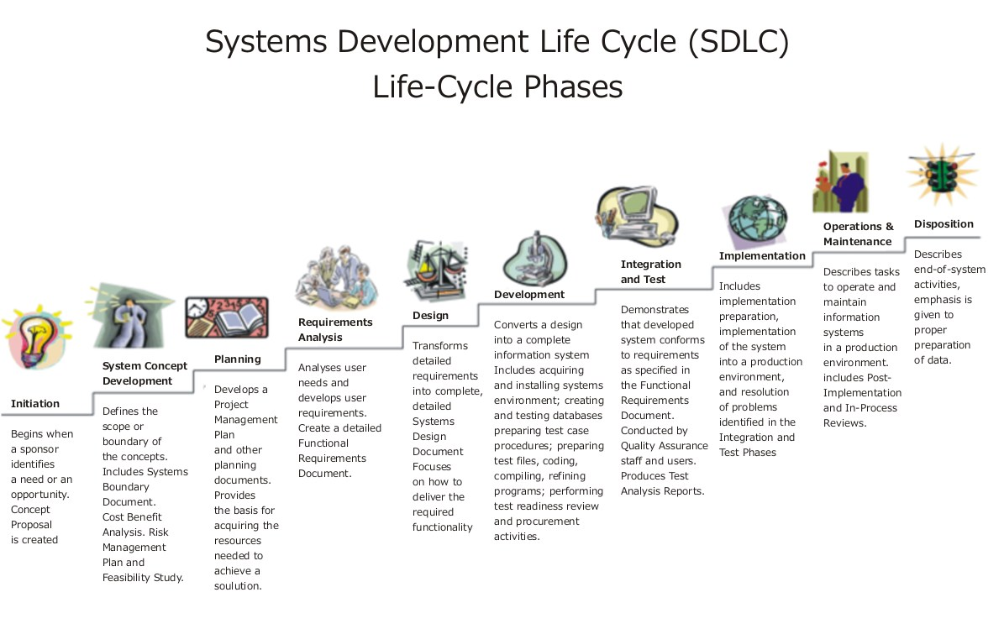
Survey in the Context
Capture the users’
satisfaction
Survey
Identify the business
needs and/or opportunity
Identify the users’ requirements
Survey
Survey
http://upload.wikimedia.org/wikipedia/commons/b/bb/Systems_Development_Life_Cycle.jpg

Slide 3


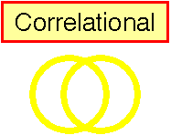


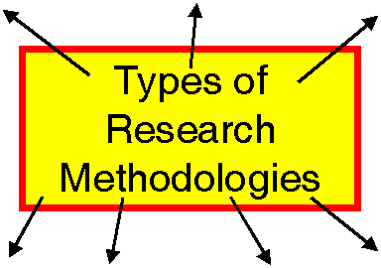








Context on Research Methods (upon which methodologies can be built)
Case Study
Types of Research Methods

Slide 4
OVERVIEW
What’s a Survey?
Survey Method
Sampling
Interviews
Questionnaires
Summary

Slide 5
What’s a Survey?
The survey is a group of research methods commonly used to determine the present status of a given phenomenon
A survey is a systematic method of collecting primary data based on a sample
Survey may be used for
exploratory,
descriptive
causal studies
Powell, 1999

Slide 6
Survey Research Design
Research design refers to how the survey will be administered in terms of:
targeted groups,
comparisons of data to multiple groups,
frequency of survey administration.
A cross-sectional survey design:
a survey is administered to a group at a defined time. For example, you may decide to measure your employees’ overall satisfaction with their jobs.
Experimental or quasi-experimental designs

Slide 7
Characteristics of Survey Research
Quick and wide coverage
In-exhaustive as opposed to in-depth
Exploratory as opposed to definitive
Descriptive as opposed to analytic
Correlational causality for experimental or quasi-experimental research

Slide 8
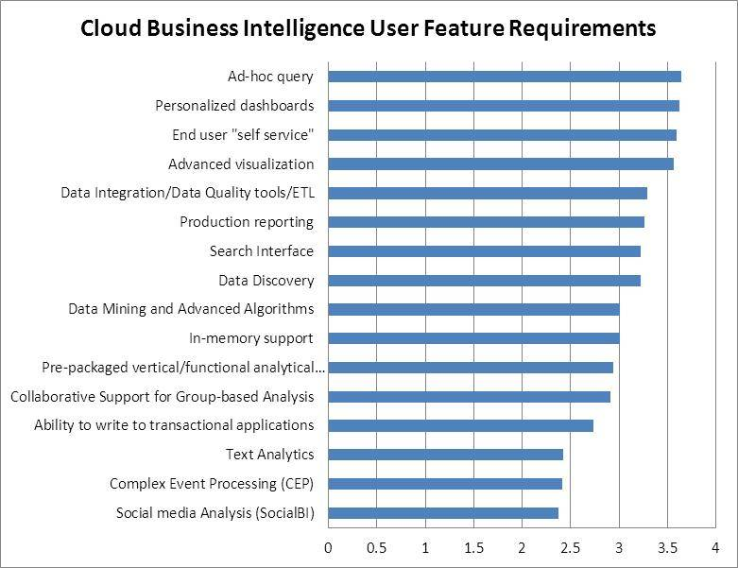
What’s the question for this Users’ Feature Requirement?
http://sandhill.com/article/dresner-advisory-study-shows-business-intelligence-in-the-cloud

Slide 9
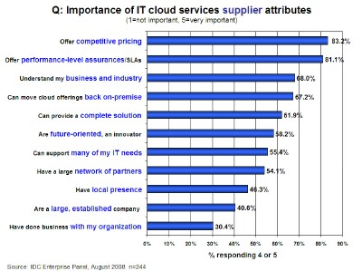
Survey of Cloud Services

Slide 10
Key concepts
Surveys should be considered to be in the same category as a test.
Each question represents a test item.
Administering the survey should be standardized.
The researcher has to consider reliability issues.
The researcher has to consider validity issues.
Effective surveys depend on asking the right questions right.
How to improve reliability and validity?

Slide 11
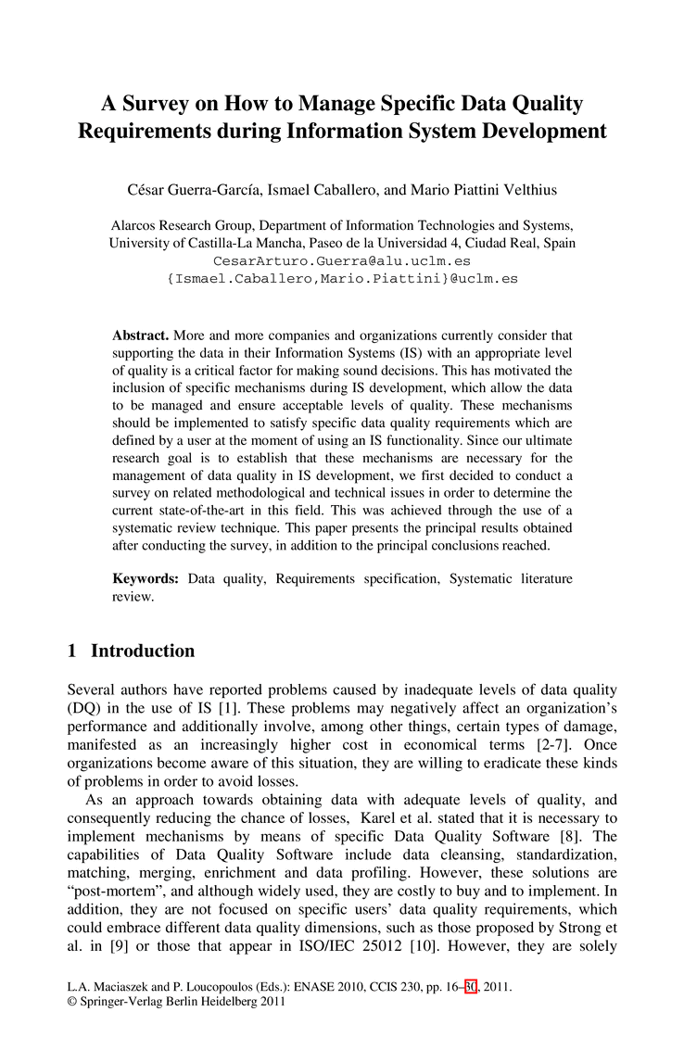
Contoh Paper Survey Research

Slide 12
Survey Method
Collecting standardized information from people using an interview or self-report format.
Typically survey knowledge or opinions.
To standardized the information one uses a questionnaire with set questions.
Ideally the questionnaire has been validated.
Representativeness of the sample is very important.

Slide 13
Interview
Direct interview
Face-to-face
Via telephone
Chat
Indirect interview
Via email

Slide 14
INTERVIEWS

Slide 15
Interview: Advantages & Disadvantages
Interviews
Advantage - Comprehensive, ensure participant understands the question, minimizes missing data, enables clarification of unclear responses
Disadvantage – expensive, people more like to refuse participation, can be risky for interviewer, interviewer may bias the responses.

Slide 16
Types of Interviews
Face-to-face interviews
Expensive and time-consuming
Telephone interviews
Need to use random-digit dialing to reach both listed and unlisted numbers.
Mail
Return rate is usually low (20-30%).

Slide 17
Unstructured interview
Questions are unplanned. The interviewer can ask questions at his/her discretion
Benefits
Cover a wide range of issues
Flexibility
Issues
Reliability
Validity

Slide 18
Structured interview
Questions are pre-planned in advance to elicit responses in a specific area
Benefits
Consistency
Even coverage
Content validity
Issues
Limits coverage

Slide 19
Standarizing Interview Procedures
read each question exactly as written
use standard probes when the person does not answer fully
record answers in the same way
be interpersonally neutral

Slide 20
Interviewing Error
Confirmation bias
an error in which the interviewer unconsciously seeks to gather information to support an established opinion or point of view

Slide 21
QUESTIONNAIRES

Slide 22
Step 1. Determine The Purpose
What do you need to know?
What can you do with the responses?
What decisions can be made from the responses?
What will you do with the responses once you have them? How will the responses be analyzed?
How will you report the responses?

Slide 23
Step 2. Target Population
To whom do you want to generalize your results?
What is your target population?
What is your sample frame?

Slide 24
Step 3. How Will The Survey Be Evaluated?
Will the responses be content analyzed?
Will the responses be computer analyzed?
What kinds of analyses will be required?
What statistical decisions will be made from the survey?

Slide 25
Step 4. How Will The survey be Administered?
Interview?
Face to face?
Group?
Telephone?
Questionnaire
Controlled group?
Pencil & paper vs. computer?

Slide 26
Step 5. Determine The Question Format
Open-Ended Questions: not provide response choices
Closed-Ended Questions: supply a certain number of responses from which respondents are expected to choose
Dichotomous Questions
Multiple-choice Questions

Slide 27
Open-ended Questions
Questions where the respondent is free to answer in his/her own words
Example:
Can you tell me about your typical experience with writing?

Slide 28
Open-Ended Questions
Advantages
Freedom of response
Sensitive to respondents’ desire for expression
Well-suited for exploratory studies
Suitable for certain types of questions
Disadvantages
Interpretation of the responses can bias the findings
Researchers must form representative categories that encompass all responses
May discourage respondents from completing the questionnaire
Coding open-ended questionnaires can be expensive and time-consuming

Slide 29
Closed-ended Questions
Questions where the respondents are limited to a fixed set of alternatives in their answers.
Example:
How do you typically find a research question?
given by someone
the future work of an article
real-life problems
discussion with experts
toss a coin

Slide 30
Close-Ended Questions
Advantages
Easy to administer
Reduce interpreter bias
Tend to motivate respondents to complete surveys
Simplify coding and tabulating efforts
Prompts choices prompts respondents to ponder alternatives they might not otherwise consider
Disadvantages
Extensive effort required in questionnaire construction to create an exhaustive list of choices or a short list of the most likely choices
The list can have an inhibiting effect on respondents
Relying on the respondent to know whether to “select one” or “check all that apply”

Slide 31
Dichotomous Questions
Closed-ended questions that only offer two response choices
Used to understand respondent’s demographic composition or behavioral inclination
Strengths
Usually do not require much time or thought on the part of the respondents
Minimize interpreter bias
Simplify coding and analysis process
Shortcomings
Omission of intermediate points

Slide 32
Multiple-Choice Questions
Multiple choice questions, are Closed-Ended questions that give respondents several choices
Strengths
Reduce interpreter bias
Easy to complete
Simple to code and analyze
Free of bias in grading
More valid and reliable than open-ended questions
Main problem
Researchers must create carefully worded questions and exhaustive lists of choices to ensure that responses are representative

Slide 33
Step 6. Question Construction
Characteristics of a good item
Single issue
Simple wording
Can the respondent answer this?
Is it relevant to the survey purpose?
Is the question neutral (leading or loaded)?
Are there issues of social desirability inherent in the question?
Number of items

Slide 34
Step 7. Develop Response Scale
Keys to good response scales
Relevant to the question
Mutually exclusive
Categories defined so that membership in one rules out membership in another
Mutually exhaustive
Categories are defined so that all possible answers fall into one of them

Slide 35
Step 8. Pilot Test
Use members of the target population.
Examine readability and interpretation.
Examine adequacy of the responses.
Examine consistency of the interviewers.

Slide 36
Step 9. Distribute The Survey
How to deliver?
How to recover?

Slide 37
Questionaire Problems
Double-barreled questions
Ambiguous questions
Ambiguous word meanings
Leading questions or phrases
Level of question difficulty
Unbalanced response categories
Missing response categories
Missing questions

Slide 38
Examples: questionaires

Slide 39
Classifying The Applications In The Portfolio
If the development applications succeeds, will it:
(a) Result in a clear competitive advantage for the business? | Yes/No
(b) Enable the achievement of specific business objectives and/or critical success factors? | Yes/No
(c) Overcome known business disadvantages in relation to competitors? | Yes/No
(d) Avoid foreseeable business risks becoming major problems in the near future? | Yes/No
(e) Improve the productivity of the business and, hence, reduce long-term costs? | Yes/No
(f) Enable the organization to meet statutory requirements? | Yes/No
(g) Provide benefits not yet known, but may result in (a) or (b) above? | Yes/No

Slide 40
Interpretation
 | High Potential | Strategic | Key Operational | Support
(a) |  | Yes
(b) |  | Yes
(c) |  |  | Yes
(d) |  |  | Yes
(e) |  |  |  | Yes
(f) |  |  | Yes | Yes
(g) | Yes

Slide 41
Interpretation
If either applies, the supplementary question is then, “is clear what the business benefits are and how they can be obtained?” If Yes it is Strategic, if No it is High Potential.
To Clarify which it is, the following question should be asked, “Will failure to comply lead to significant business risks (be specific about the risk)?” if Yes it is Key operational, if No it s Support.

Slide 42
Good or Bad Examples?
How friendly do you feel the information system?
a. Yes
b. No
How frequent do you use the information system?
a. 0 – 15
b. 15 – 20
c. 22 – 30
d. 33 – 50

Slide 43
Pertanyaan berikut berhubungan dengan pemahaman VISI dan MISI BPN
Untuk menjadi BPN yang mampu melihat ke depan, melakukan sesuatu yang dibutuhkan, dipikirkan, dan dirasakan oleh rakyat maka visi BPN seyogianya mencakup:
Menjadi lembaga pertanahan yang fokus untuk kemakmuran rakyat
Menjadi lembaga yang fokus pada masalah pertanahan dalam lima tahun kedepan
Menjadi lembaga yang mampu mengemban amanat Sila kelima Pancasila dan Pasal 33 ayat 3 UUD 45
Menjadi satu-satunya lembaga pemerintah yang berkompeten dalam bidang pengelolaan pertanahan nasional
Menjadi lembaga yang berorientasi pada penyelesaian masalah sengketa tanah
.........................................
.........................................
To test the knowledge of top management
about their vision and mision

Slide 44
2. BPN mengembangkan dan menyelenggarakan politik dan kebijakan pertanahan untuk :
Peningkatan kesejahteraan rakyat, penciptaan sumber-sumber baru kemakmuran rakyat,
Pengurangan kemiskinan dan kesenjangan pendapatan, serta pemantapan ketahanan pangan;
Peningkatan tatanan kehidupan bersama yang lebih berkeadilan dan bermartabat dalam kaitannya dengan P4T;
Perwujudan tatanan kehidupan bersama yang dinamis dan saling menguntungkan;
Keberlanjutan sistem kemasyarakatan, adat dan kebiasaan dengan menerapkan prinsip kemakmuran bersama;
.....................................................
………………………………………

Slide 45
3. (Cukup pilih satu jawaban saja) Seberapa dalam visi dan misi BPN telah mengakar di lingkungan kerja dibawah tanggung jawab Anda?
Sangat dalam
Dalam
Cukup dalam
Tidak dalam
Tidak mengakar sama sekali

Slide 46
Tabulate: questionaires

Slide 47
Self report
Numerical scales
Semantic differential
Graphic rating scale
Behaviorally anchored scale
Forced choice

Slide 48
Likert Scale
Tingkat kepuasan PELANGGAN thd pelayanan Yang Diberikan
Sangat tidak puas
Tidak terlalu puas
Tidak puas
Cukup puas
Puas
Sangat puas
Sangat puas sekali
1
2
3
4
5
6
7
Tidak penting sekali
Tidak terlalu penting
Tidak penting
Cukup penting
Penting
Sangat penting
Sangat sangat penting
Tingkat kepentingan PELANGGAN thd pelayanan yang Diharapkan

Slide 49
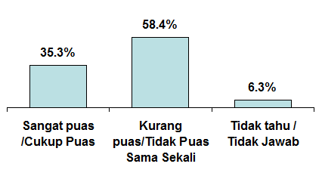
Contoh: Tabulasi Jawaban dalam Grafik

Slide 50
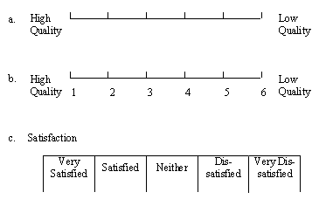
Graphic Rating Scale
http://survey.pearsonncs.com/planning/response-scales.htm

Slide 51
Rank Ordering
Example:
Rank order your preference for the following ice cream flavors from 1= most preferred, to 5 = least preferred.
____ Chocolate
____ Vanilla
____ Cherry
____ Banana
____ Broccoli

Slide 52
Q/A

